Slide 1

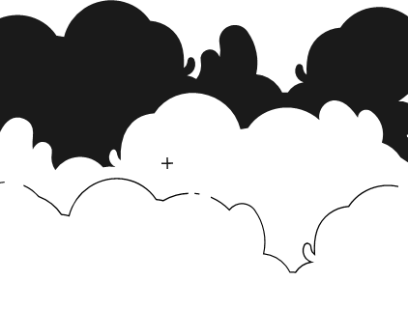
PRINCIPLES OF ARTIFICIAL INTELLIGENCE
SOF106
DR SHAMINI RAJA KUMARAN
FS + CONFUSION MATRIX
www.website.com
PREPARED BY DR SHAMINI

Slide 2
XMUM VISION
Xiamen University Malaysia aspires to become a university with a distinct global outlook, featuring first-class teaching and research, and embracing cultural diversity.
XMUM MISSION
To nurture young talents with dignity and wisdom, turning them into fine citizens of the region who will contribute to the prosperity of the people and social progress of Malaysia, China and Southeast Asia.To nurture young talents with dignity and wisdom, turning them into fine citizens of the region who will contribute to the prosperity of the people and social progress of Malaysia, China and Southeast Asia.

Slide 3
FEATURE SELECTION
Feature selection is a step to choose a subset of the most relevant and informative features (variables or attributes) from your dataset while discarding irrelevant or redundant ones.
Feature selection offers several advantages, including simplifying models, improving model performance, reducing overfitting, and speeding up training times.
WEKA provides a variety of feature selection algorithms. You can choose from methods like CfsSubsetEval, CorrelationAttributeEval, GainRatioAttributeEval, and more.
To select an algorithm, click on the "Evaluator" dropdown menu and choose the desired algorithm.
In addition to the Evaluator (feature evaluation method), you also need to choose a "Search" method. The search method defines how the algorithm explores the feature space. Common search methods include BestFirst, GreedyStepwise, Ranker, and others.
Click on the "Search" dropdown menu to select the desired search method.

Slide 4
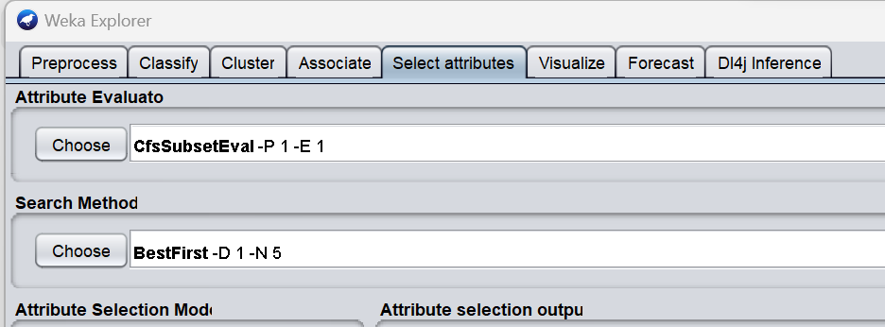
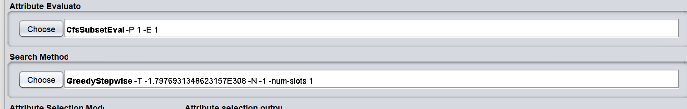
BEST FIRST SEARCH
FEATURE SELECTION
Open the Weka GUI Chooser.
Click the “Explorer” button to launch the Explorer.
Open the credit-g.arff dataset.
Click the “Select attributes” tab to access the feature selection methods.
To identify the accuracy based on the selected features.

Slide 5
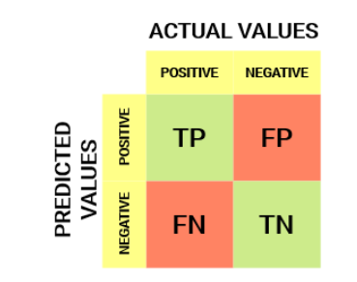
CONFUSION MATRIX
Confusion matrix is a performance evaluation tool in machine learning, representing the accuracy of a classification model.
It displays the number of true positives, true negatives, false positives, and false negatives. This matrix aids in analyzing model performance, identifying mis-classifications, and improving predictive accuracy.
A Confusion matrix is an N x N matrix used for evaluating the performance of a classification model, where N is the total number of target classes. T

Slide 6
CONFUSION MATRIX
True Positive (TP)
The predicted value matches the actual value, or the predicted class matches the actual class.
The actual value was positive, and the model predicted a positive value.
True Negative (TN)
The predicted value matches the actual value, or the predicted class matches the actual class.
The actual value was negative, and the model predicted a negative value.
False Positive (FP) – Type I Error
The predicted value was falsely predicted.
The actual value was negative, but the model predicted a positive value.
Also known as the type I error.
False Negative (FN) – Type II Error
The predicted value was falsely predicted.
The actual value was positive, but the model predicted a negative value.
Also known as the type II error.

Slide 7
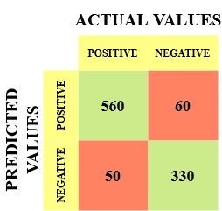
CONFUSION MATRIX
True Positive (TP) = 560, meaning the model correctly classified 560 positive class data points.
True Negative (TN) = 330, meaning the model correctly classified 330 negative class data points.
False Positive (FP) = 60, meaning the model incorrectly classified 60 negative class data points as belonging to the positive class.
False Negative (FN) = 50, meaning the model incorrectly classified 50 positive class data points as belonging to the negative class.

Slide 8

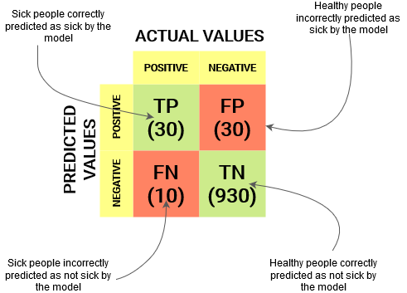



CONFUSION MATRIX

Slide 9
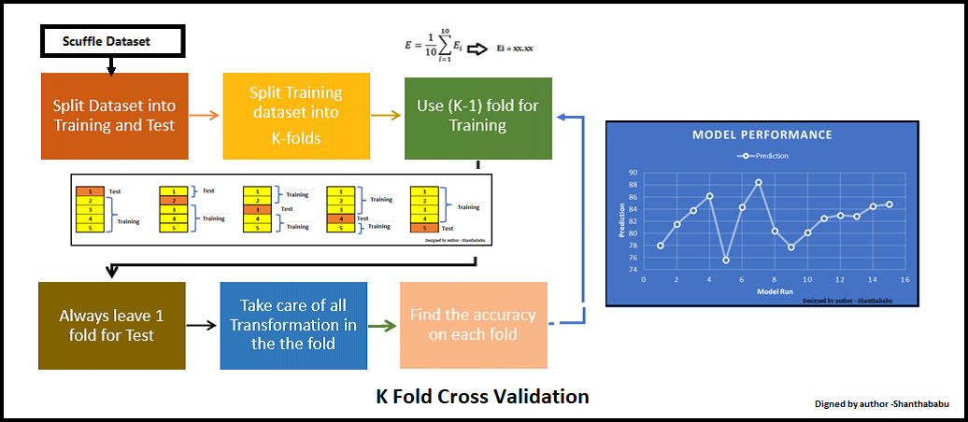
CROSS-VALIDATION

Slide 10
THANK YOU
www.website.com
PREPARED BY DR SHAMINI

